Slide 1
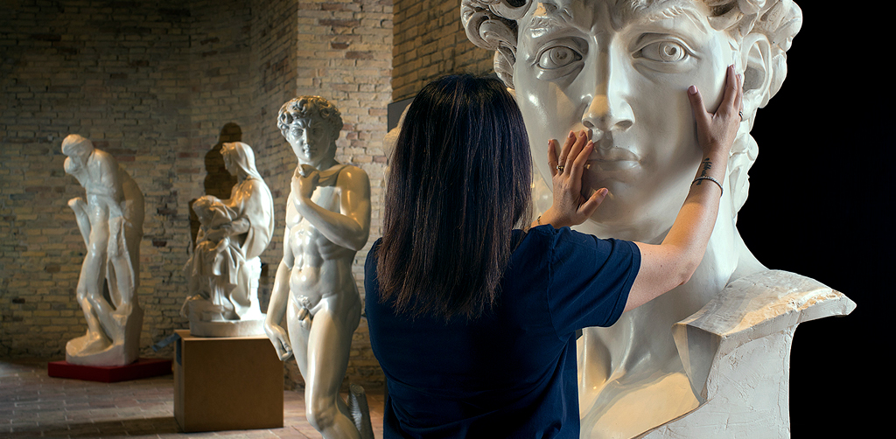


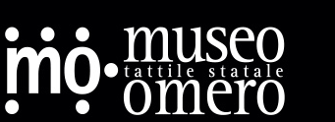
Design and implementation of a MongoDB database for the management of the State Omero Museum
Valerio Morelli
Federico Staffolani
Enrico M. Sardellini
a.y. 2024/2025
New Generation Databases Examination Project

Slide 2
The Omero Museum Today

Slide 3
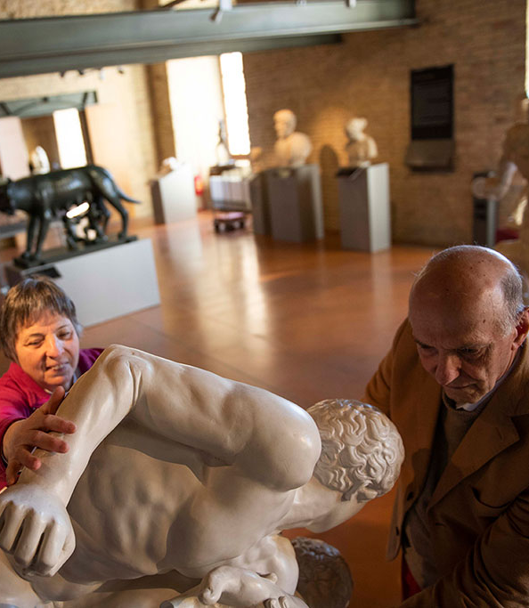
The Omero Museum
Pioneer in the field of tactile art and a model of accessibility and inclusion:
“You can touch!”
May 29, 1993 → Established with the contribution of Marche
November 25, 1999 → Recognized as a state museum by the Parliament
August 3, 2001 → Managed by Ancona and Ministry of Culture
Foundation (1/1)

Slide 4
Requirement Analysis

Slide 5
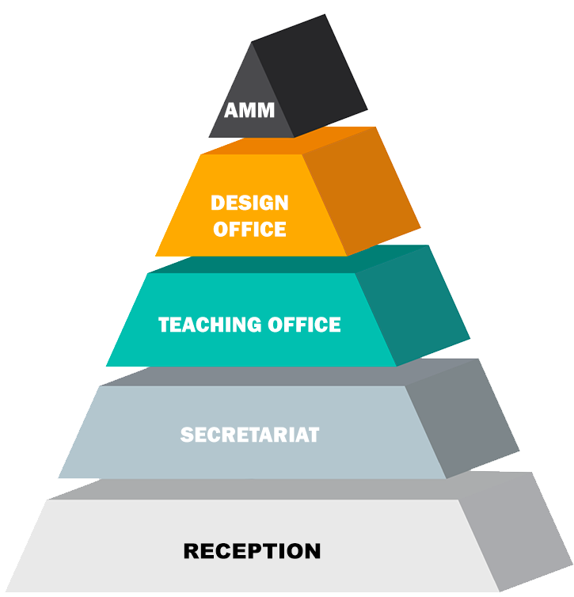
Internal organization
Financial/economic side.
Plans exhibitions and conferences.
Supervises workshop activities.
Handles internal management
Organizes guided tours
Requirement Analysis (1/5)

Slide 6
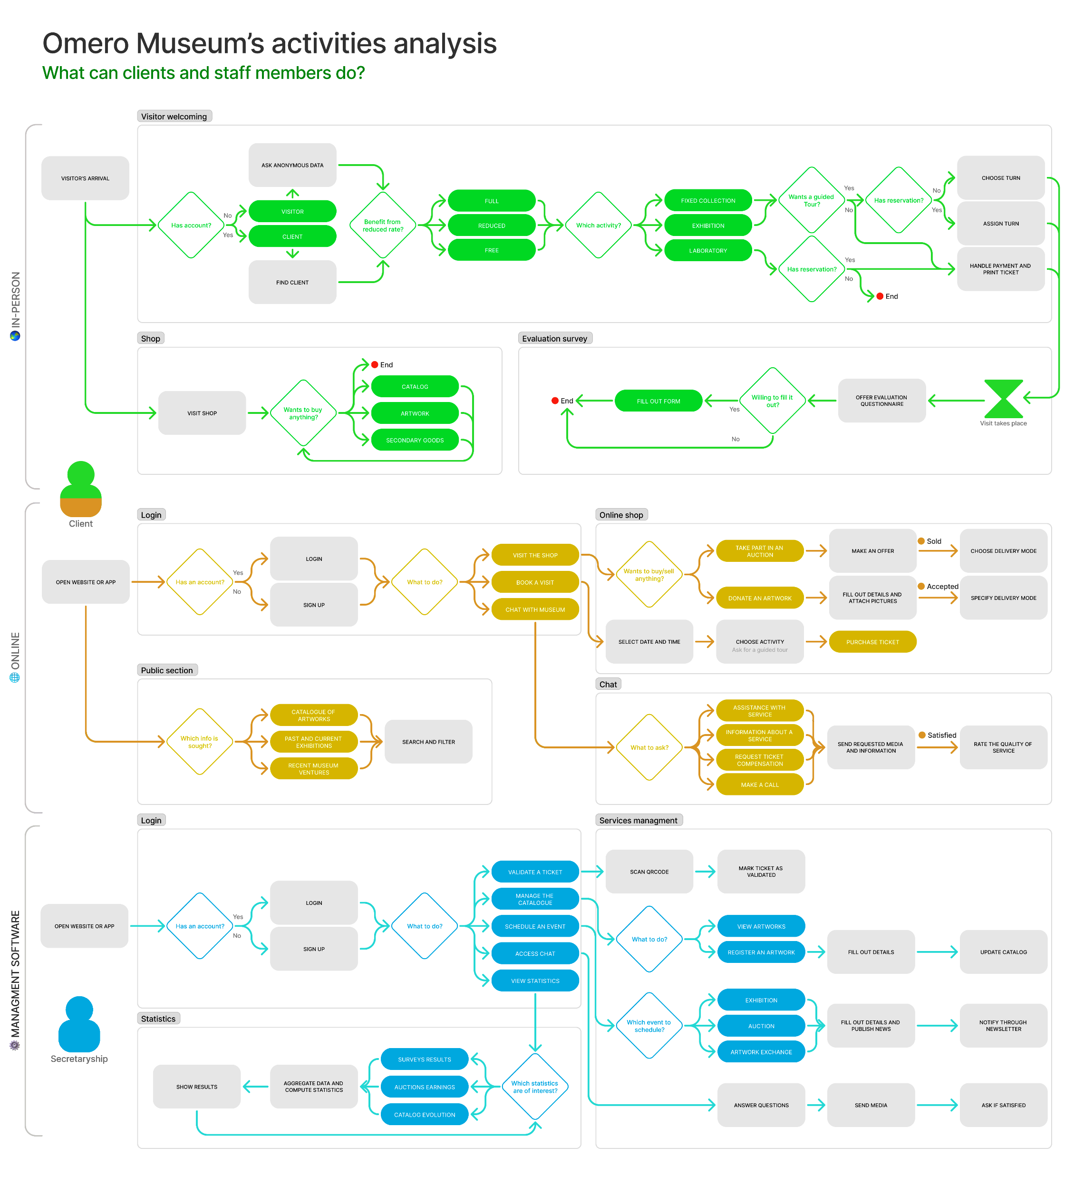

Services offered
Requirement Analysis (2/5)

Slide 7
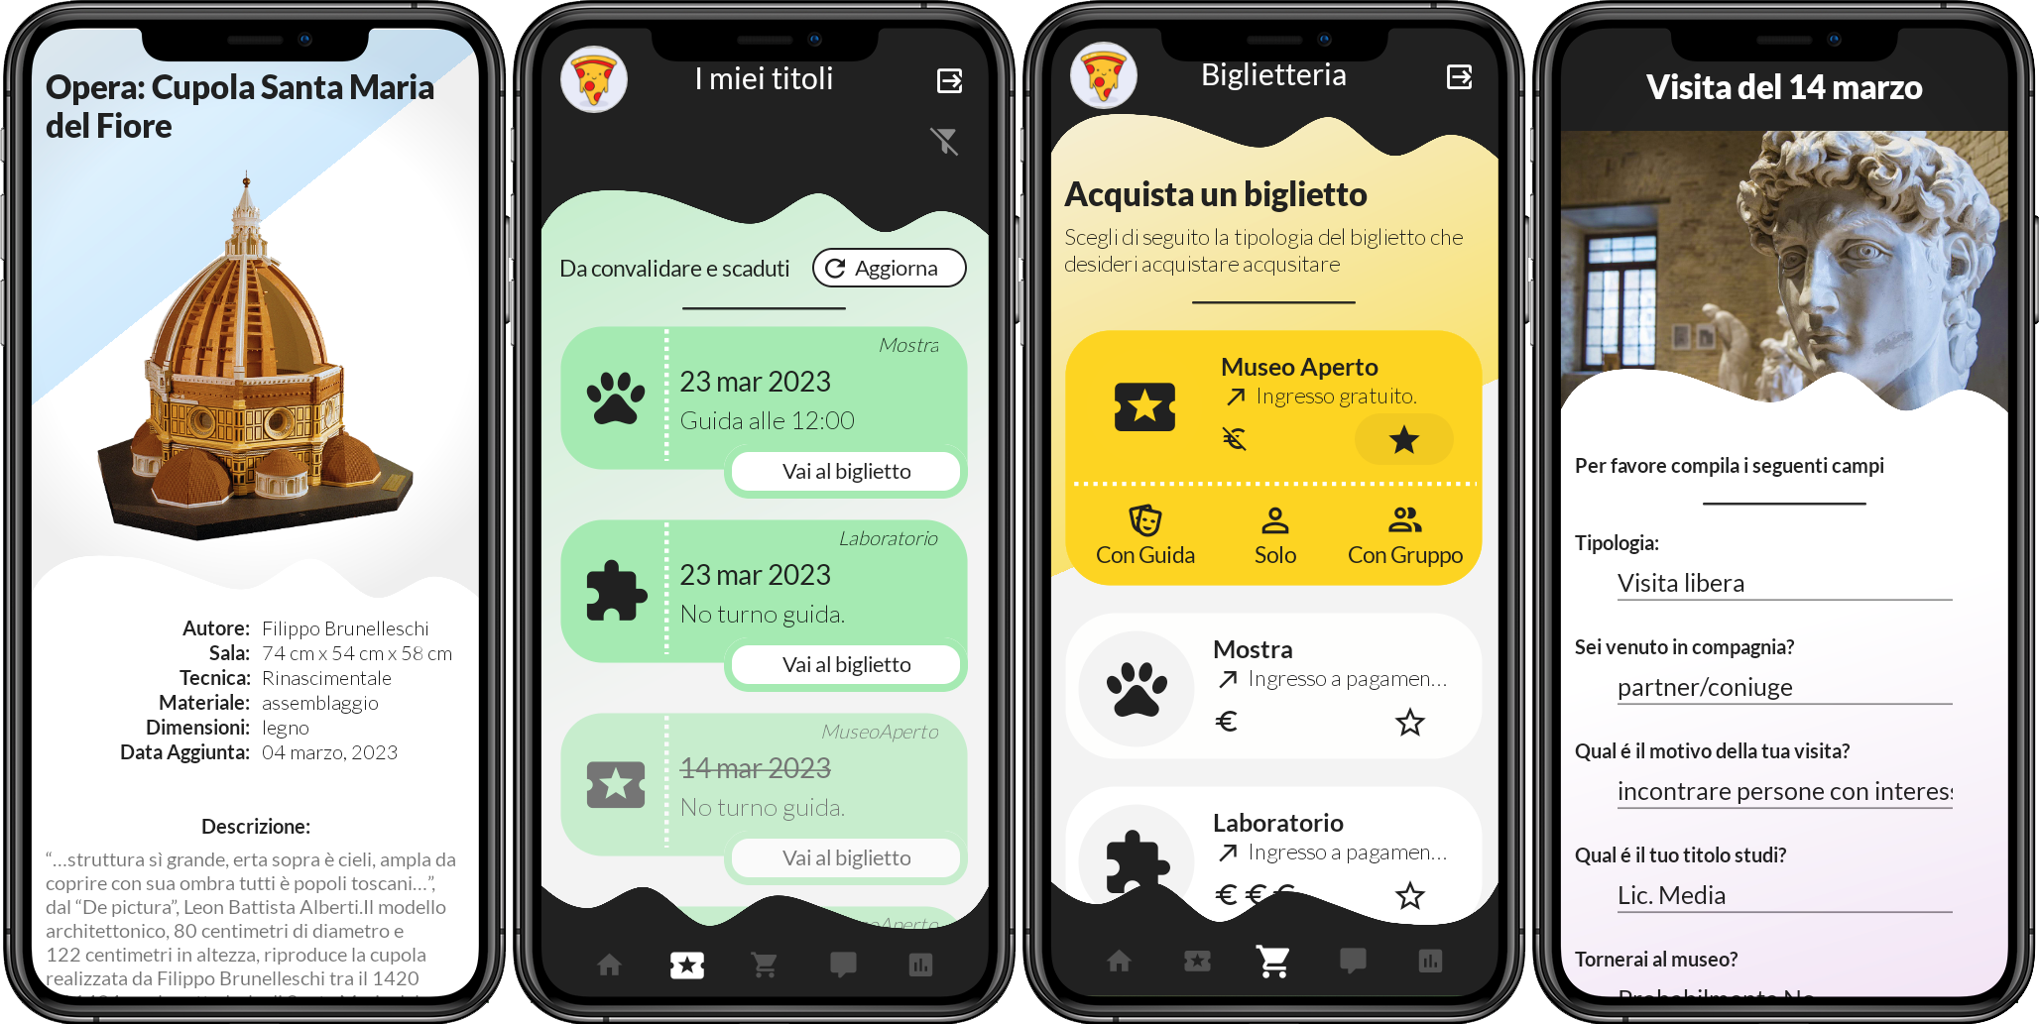
Requirement Analysis (3/5)

Slide 8
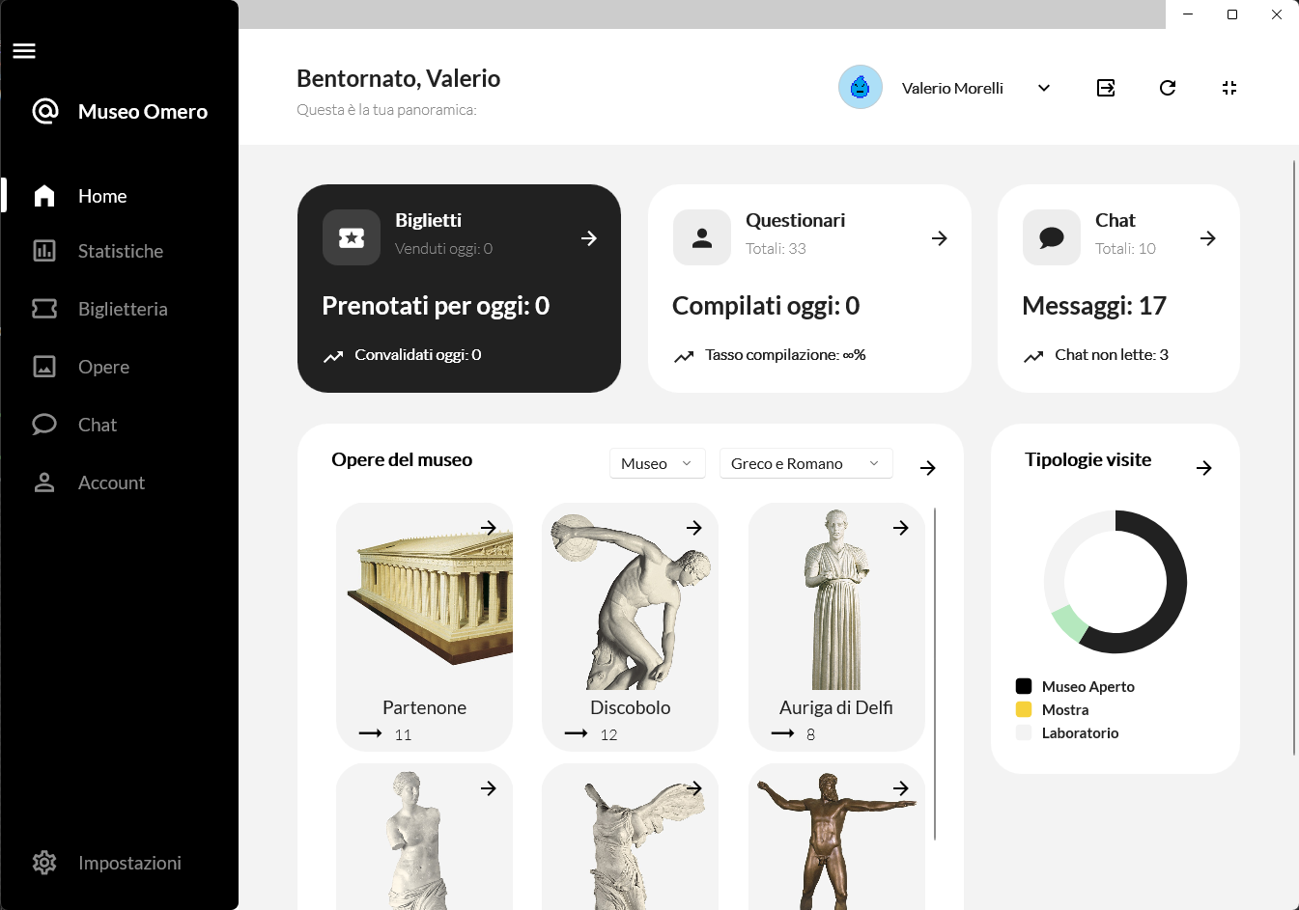
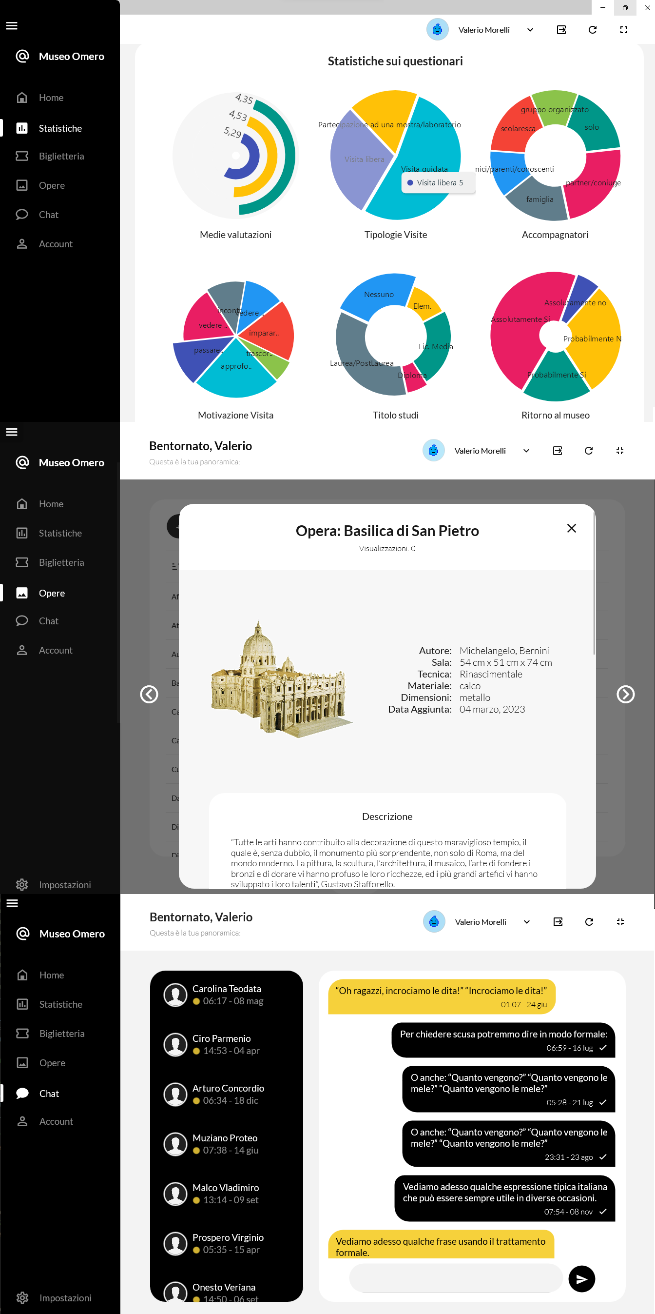
Requirement Analysis (4/5)

Slide 9
The need for a NoSQL transition
Flexibility: last-minute exhibitions, artist invitations, and temporary artwork exchanges. This dynamism requires a flexible schema.
Horizontal Scalability: auctions and limited-events generate traffic spikes.
Eventual consistency: most data changes are non-critical.
OLAP: administration runs statistical analysis, often involving subsets of fields in the records
Document mapping: many of the museum's entities, map naturally into nested objects.
Requirement Analysis (5/5)

Slide 10
The logical design

Slide 11
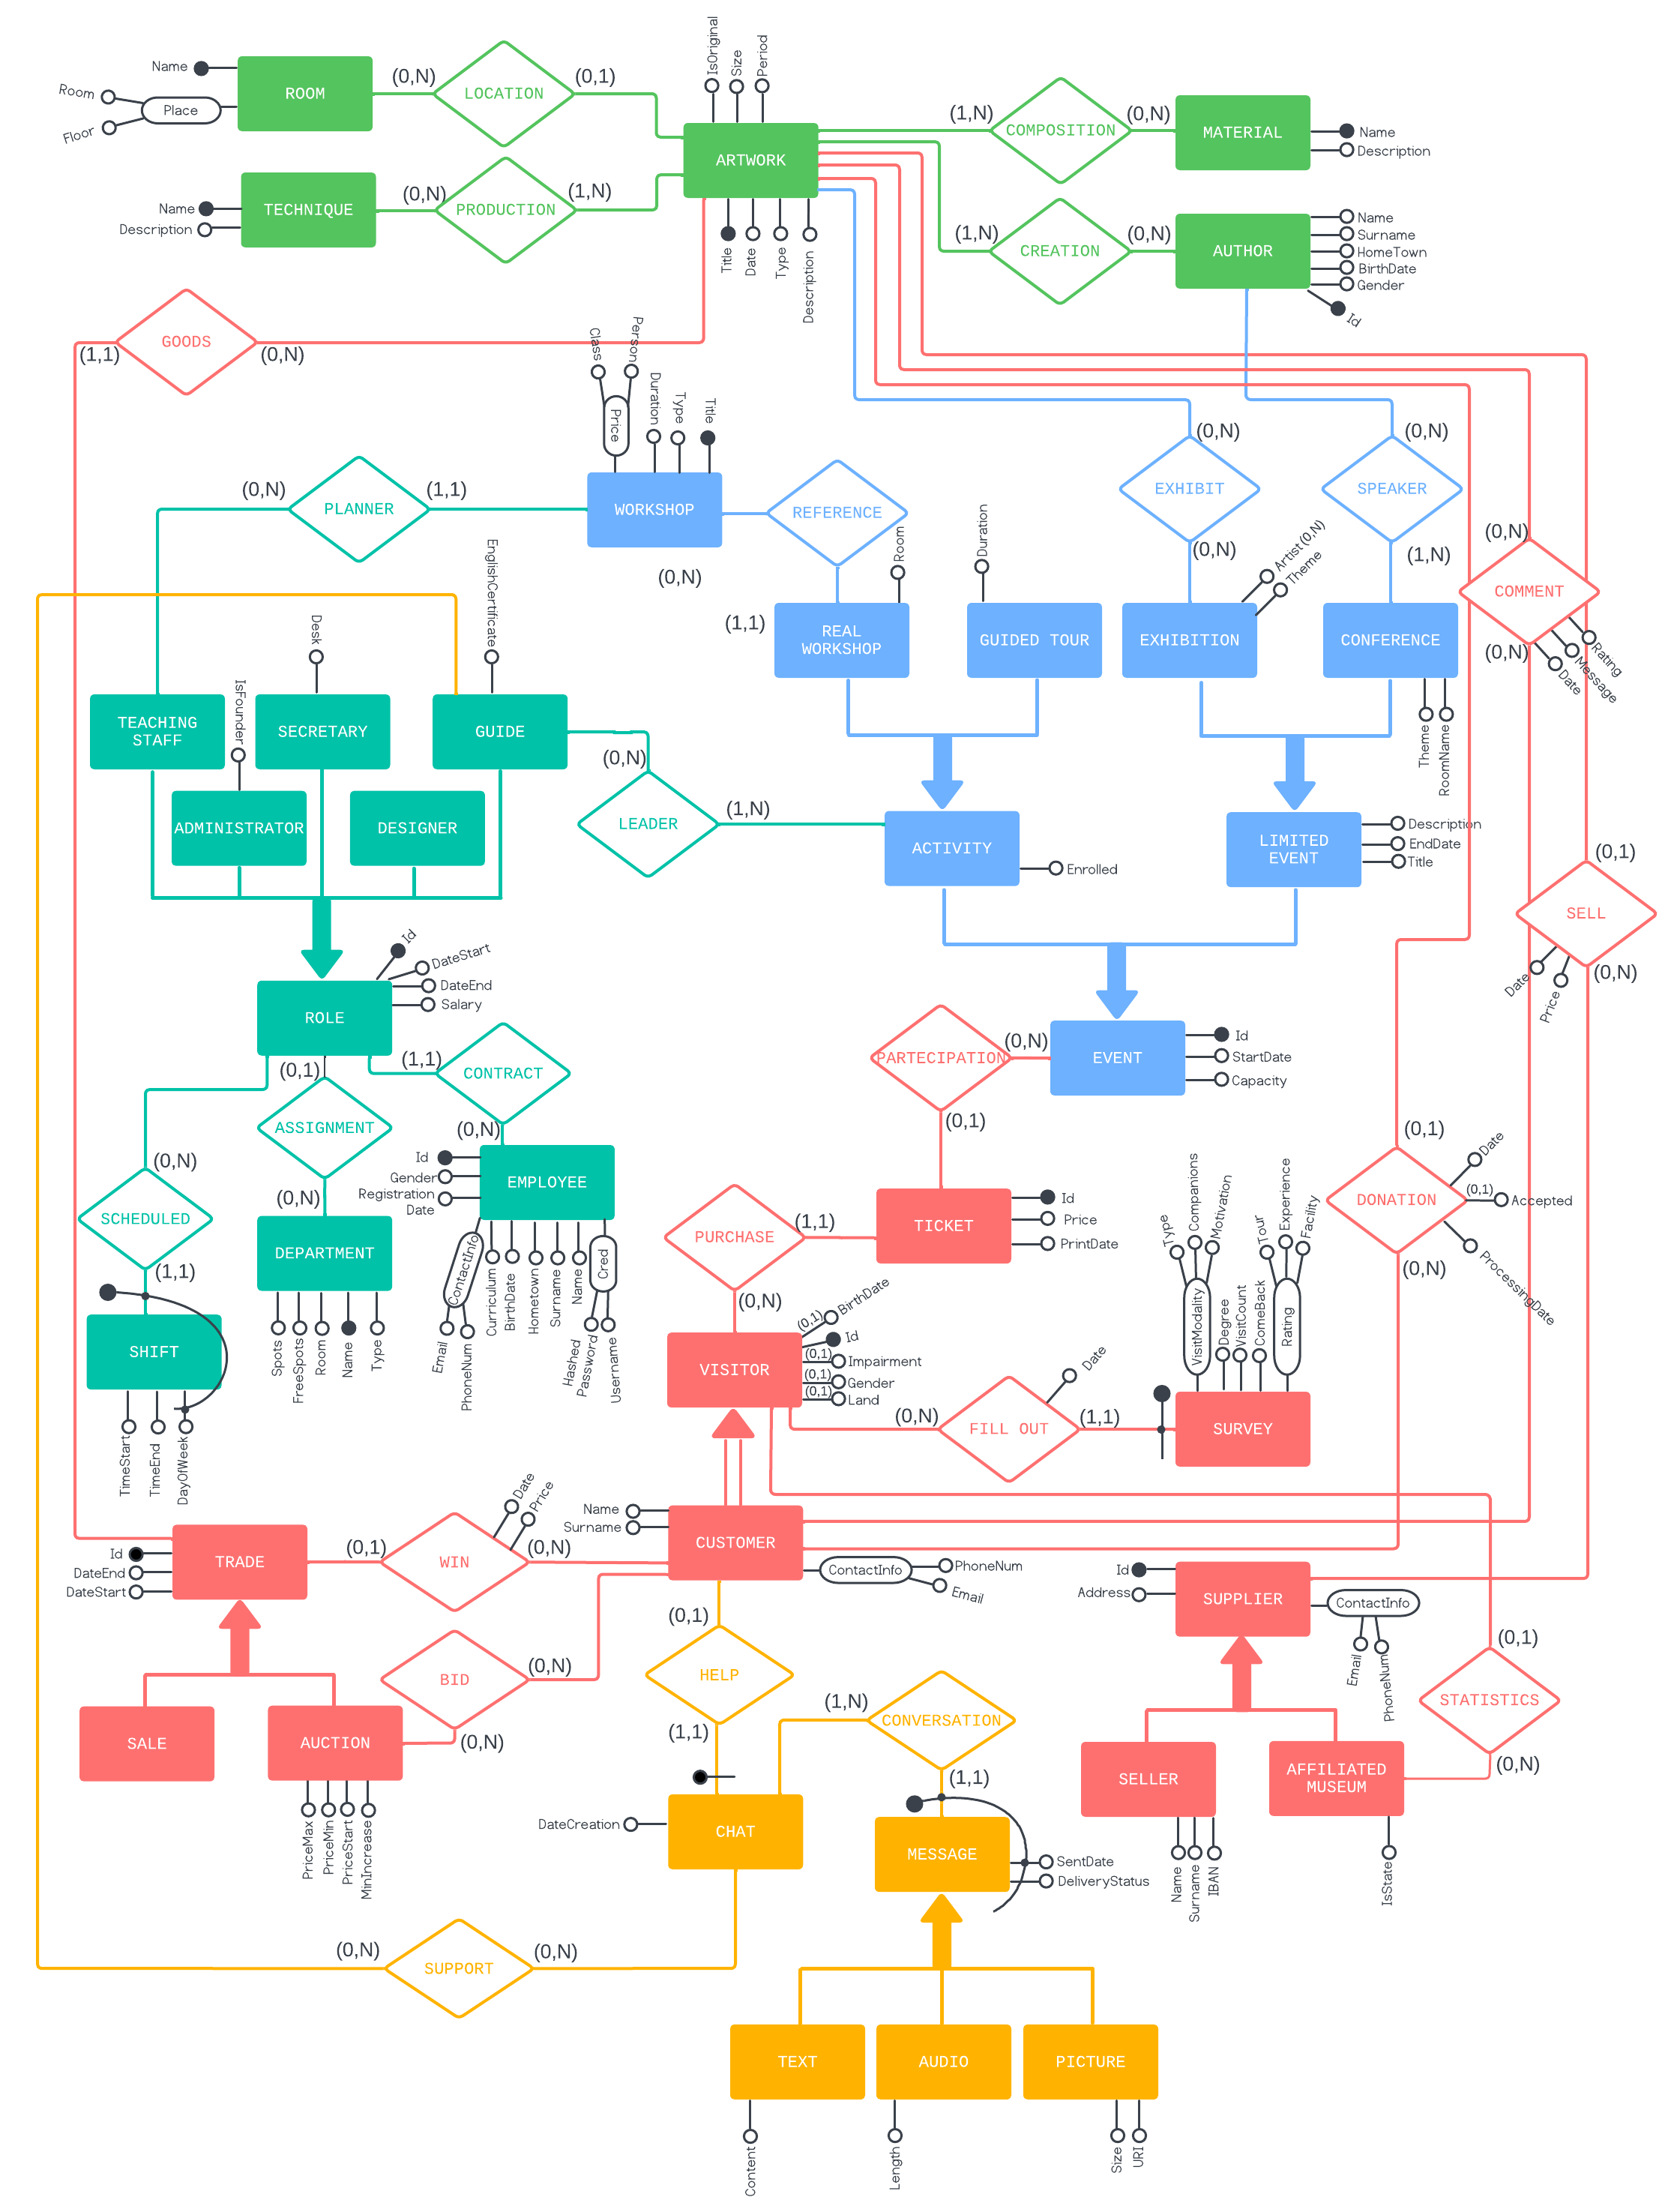
ER Diagram (from MySQL design)
The logical design (1/5)

Slide 12
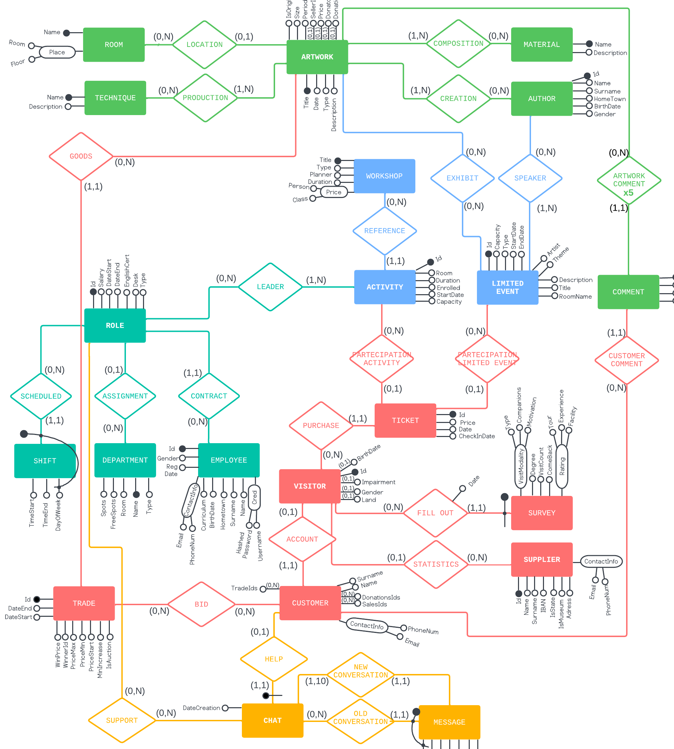

Hierarchies’ removal
According to the literature, there are three approaches to removing hierarchies:
Unify children in the root.
Copy root in children.
Convert hierarchy into relationship.
NoSQL is schemaless $⇒$ Flexibility $⇒$Unify children in the root is convenient
The logical design (2/5)

Slide 13


Horizontal Partitioning
Boundless growing entities risk dramatically increasing the size of the aggregates when embedded inside others.
If an item exceeds the size of a block, multiple read accesses are required.
Survey,
Ticket
Message
Comment
Bid
Read 10 at the time $⇒$ Hybrid approach
Skewed.
Rating-based partition
Too many op.
B+-tree on insertion date
Auctions are temporary $⇒$ ignore
The logical design (3/5)

Slide 14
Used Design Patterns
Computed + Approximation
Compound key
Ticket’s, Chat’s and Trade’s count
estimated_document_count()
Message’s key =
customerId + sentDate
Historization
Inheritance
Messages are partitioned based on insertion date
Visitor collection, includes heterogeneous documents
The logical design (4/5)

Slide 15
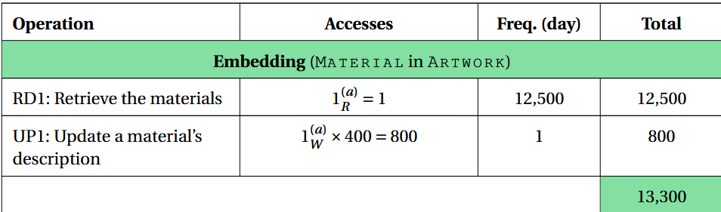
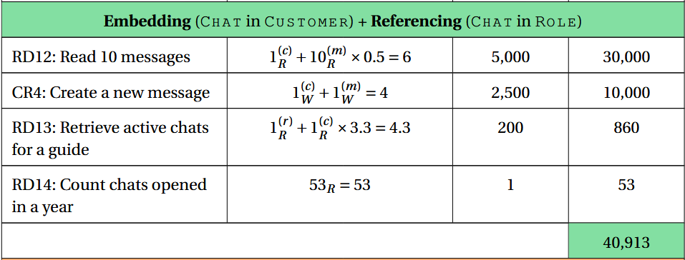
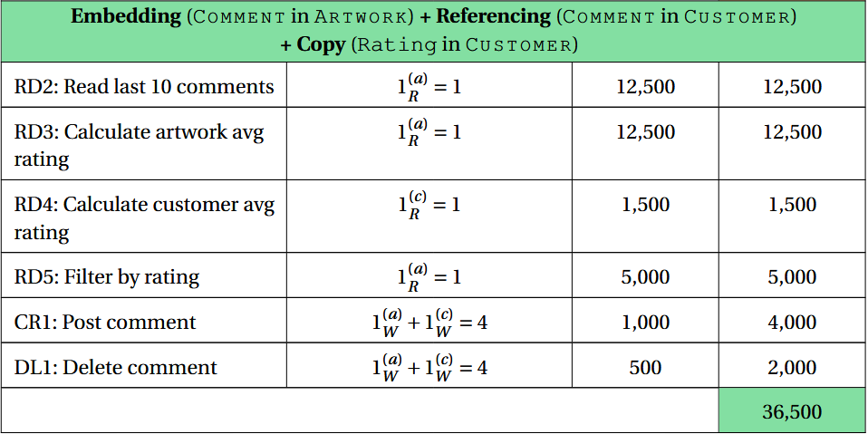
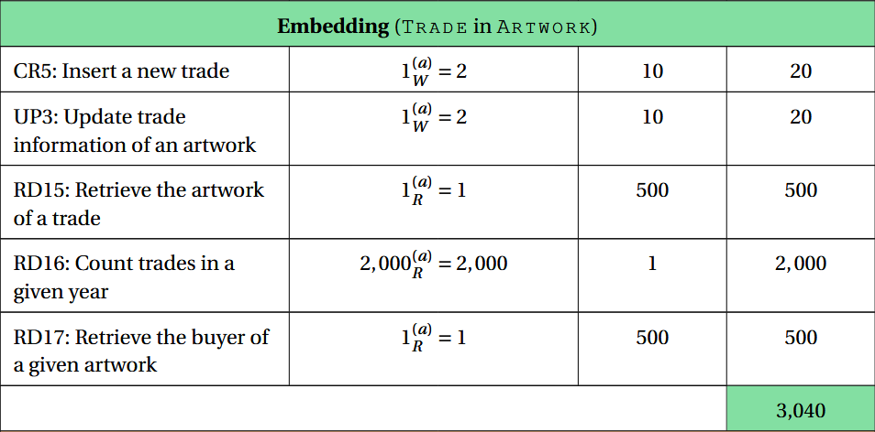
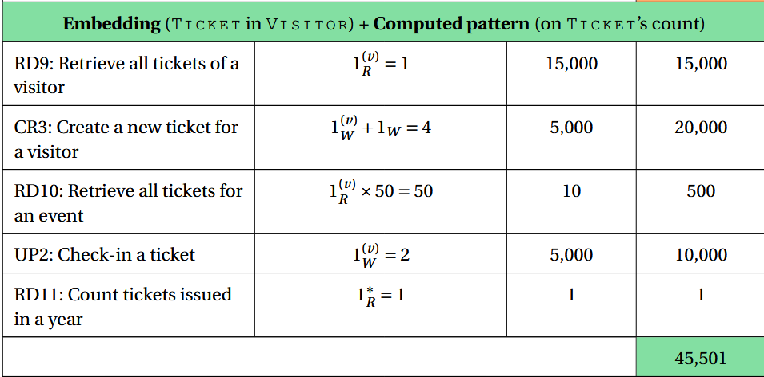
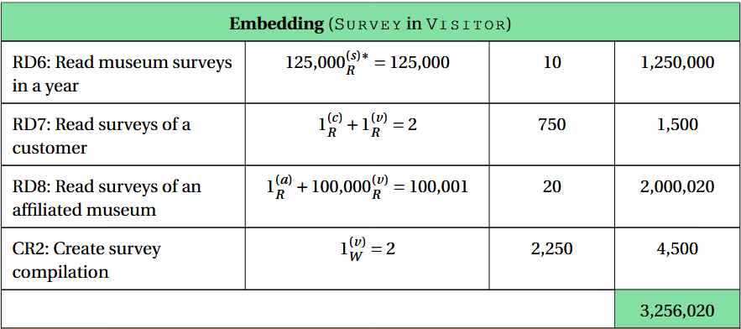
The logical design (5/5)

Slide 16
Implementation details

Slide 17
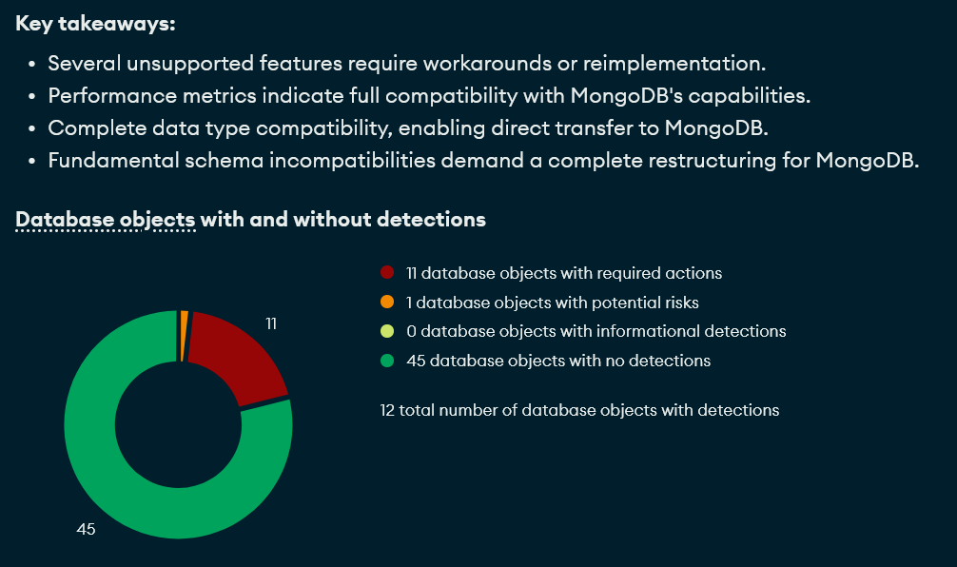
Migration from MySQL
Implementation details (1/3)

Slide 18
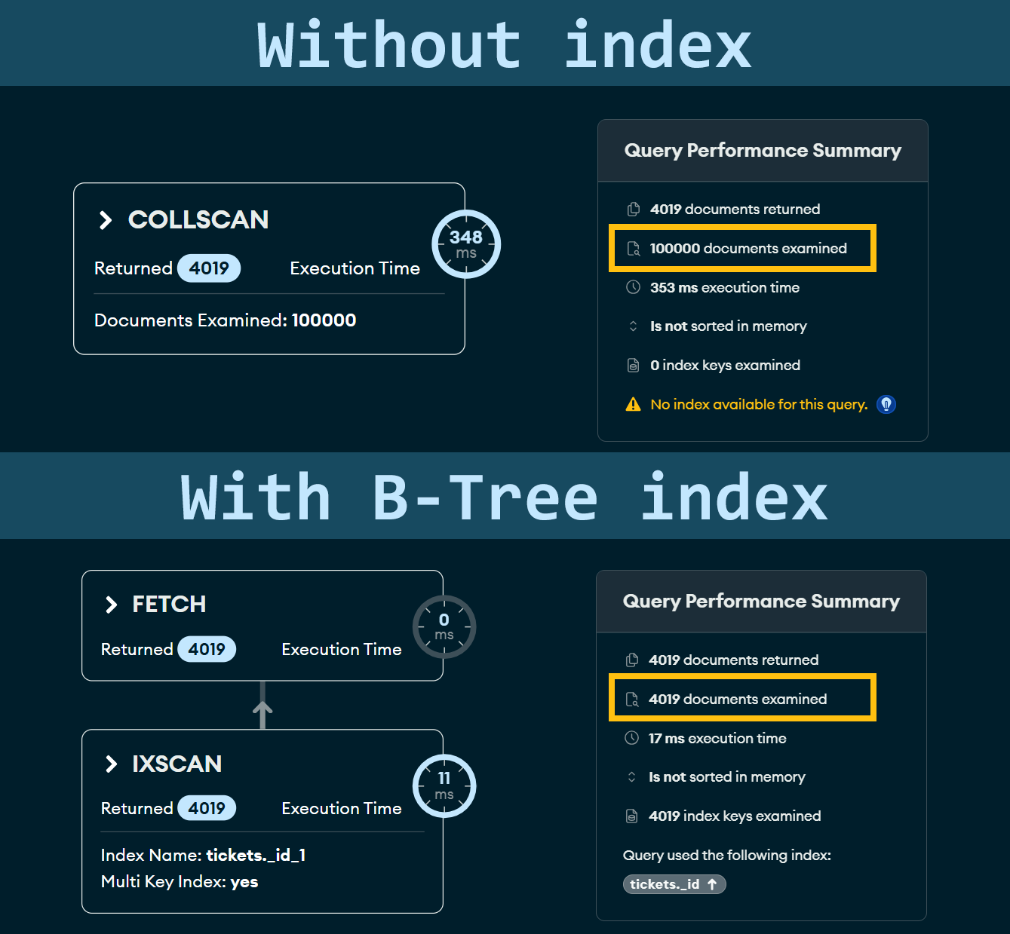
Indexes on embedded documents
Visitor
Event
Ticket 1
Ticket 2
Tickets must have an _id.
An index is defined on it
Implementation details (2/3)

Slide 19
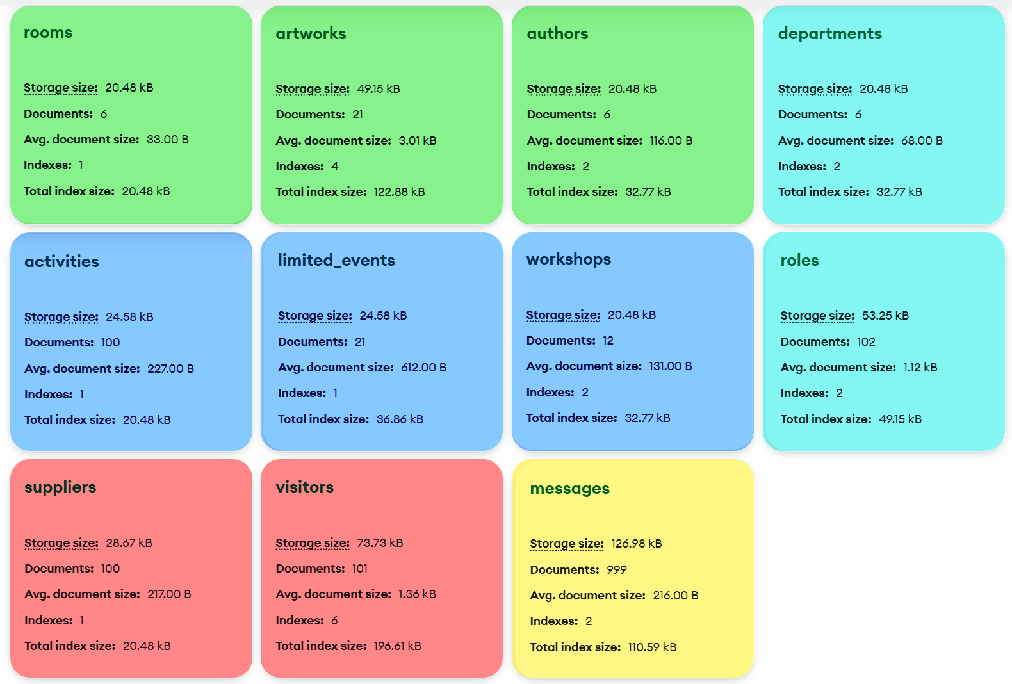
Implementation details (3/3)

Slide 20
A comparison of alternative solutions designed by LLMs

Slide 21
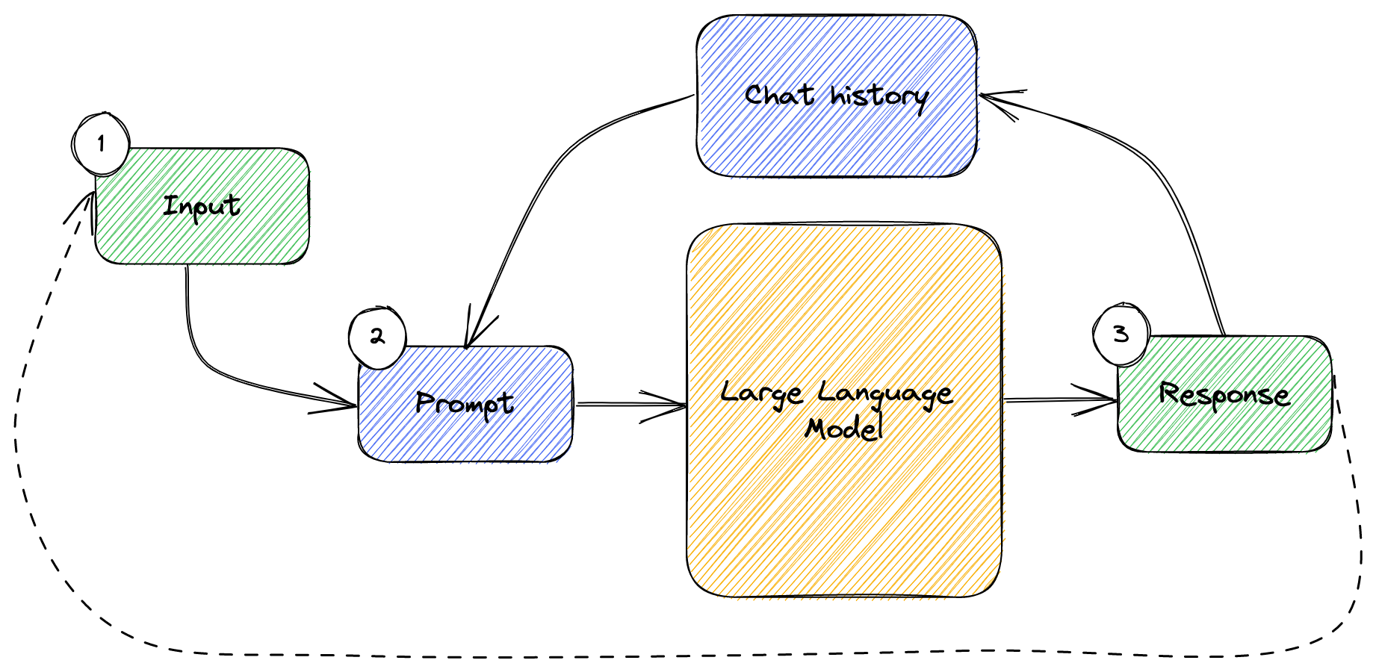
1. Prompt Chaining
A comparison of alternative solutions designed by LLM (1/3)

Slide 22
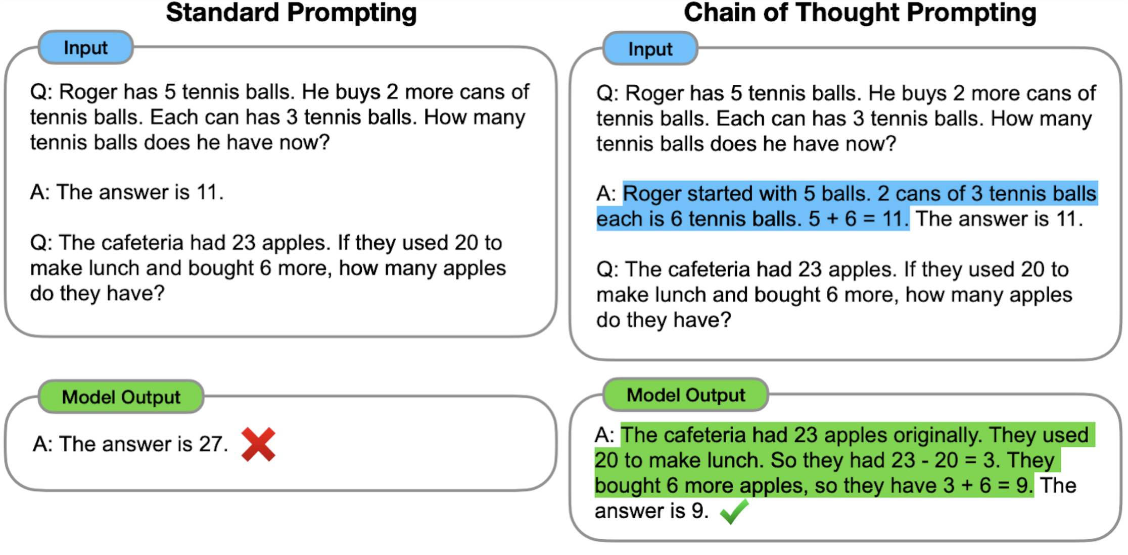
2. Chain of Thought
A comparison of alternative solutions designed by LLM (2/3)

Slide 23
Model | Artwork collection | Visitor collection | Trade collection | Overall strategy
GPT 4.5 | Embeds recent COMMENT, embeds MATERIAL, AUTHOR (also suggests denormalization), references ROOM | References TICKET but uses small denormalized VISITOR snapshot for efficiency | Embeds snapshot of ARTWORK in TRADE (low volume of transactions and need for quick access) | Quantitative: aggressive embedding for read-intensive, low-update entities. Cost/performance-driven.
Gemini 2.5 Pro | Embeds MATERIAL, TECHNIQUE, ROOM (low cardinality), references AUTHOR and COMMENT (high cardinality) | Reference VISITOR in TICKET, treats TICKET as independent aggregate (due to volume and lifecycle) | Embeds limited ARTWORK snapshot, embeds BID fully (reading an auction is often accompanied by reading all bids) | Traditional: minimizes redundancy, favors consistency and separation of high-cardinality entities.
Claude Opus 4.1 | Embeds MATERIAL, TECHNIQUE, AUTHOR (stable entities), references ROOM and COMMENT (dynamic entities) | References TICKET, sees it as autonomous aggregate (frequent updates, high transactions) | References ARTWORK (less redundancy), embeds BID | Balanced: embeds stable, low-cardinality entities; references dynamic or high-volume entities.
A comparison of alternative solutions designed by LLM (3/3)

